Slide 1
waffle
Toby Chappell

Slide 2
Waffle Plots
Waffle plots show the count of something in relation to the whole
Can be used to show proportionality similar to pie charts

Slide 3
Waffle Plots in R
The waffle package in R is built on top of ggplot2
For basic waffle plots, the "waffle" package is sufficient
For more complex waffle plots, it would probably be ideal to install the “hrbrthemes” as well
https://github.com/hrbrmstr/waffle/blob/master/README.md

Slide 4
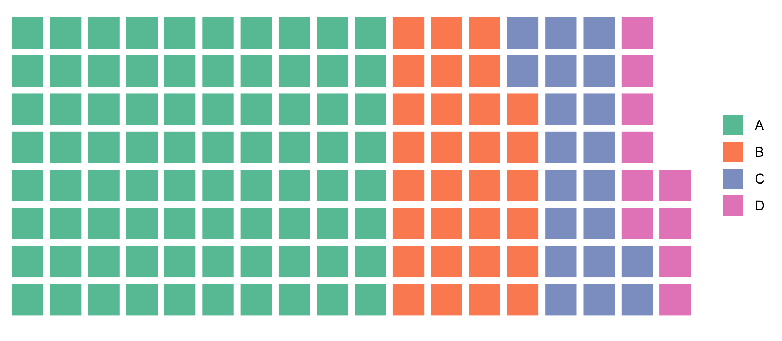
Basic Waffle Plot
For the simplest waffle plot, you just need the counts of each section
You can also connect to a Data.Frame and get the counts of each section using dyplr

Slide 5
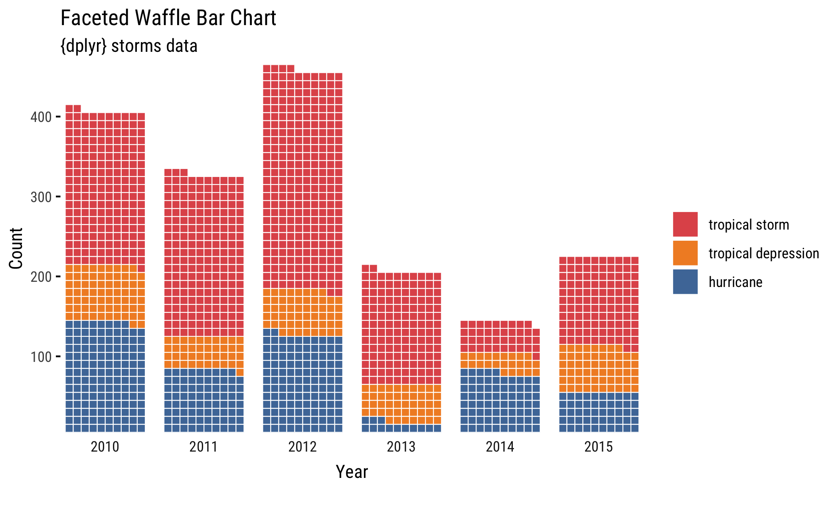
Faceted Waffle Plot
You can break waffle plots into sub categories and stitch them together using a facet wrap
This is really useful for showing count and proportionality over time

Slide 6
Pictograms
Allows you to use glyphs for your waffle plot (these are also know as an isotype pictograms)
Able to convey additional meaning through the use of images
Font Awesome 5 is used in the package to accomplish this

